Slide 1



Past and new technological developments at LOV for core and new BGC applications
E. Leymarie, A. Poteau, C. Penkerc’h, N. Alem, A. Pierret, V. Taillandier, F. D’Ortenzio, H. Claustre
Laboratoire d’Océanographie de Villefranche

Slide 2


Acknowledgements
Technological developments are always a team work !
LOV : Antoine Poteau, Christophe Penkerc’h, A. Pierret, V. Taillandier, N. Alem, F. D’Ortenzio, H. Claustre
Strong and good collaboration with Ifremer and NKE

Slide 3
Presentation Outline
Provor CTS4 : A float developed for the BGC core Argo mission
Provor CTS5 : A float developed for R&D and demanding application
  R&D facilities at LOV
  Past developments
  On going developments
Conclusion and perspectives.

Slide 4
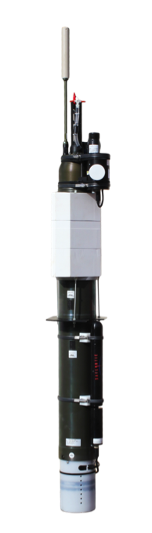
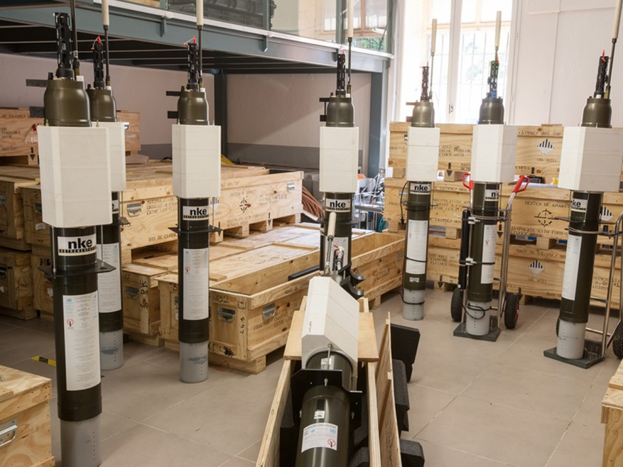
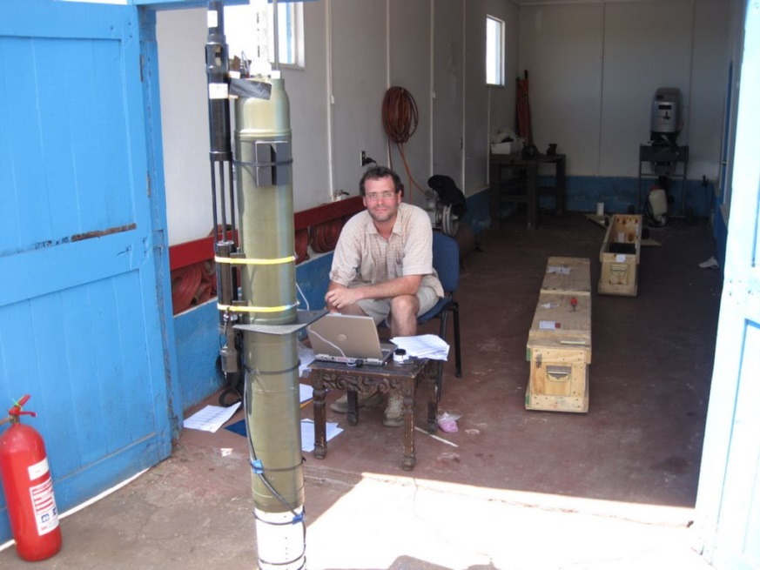
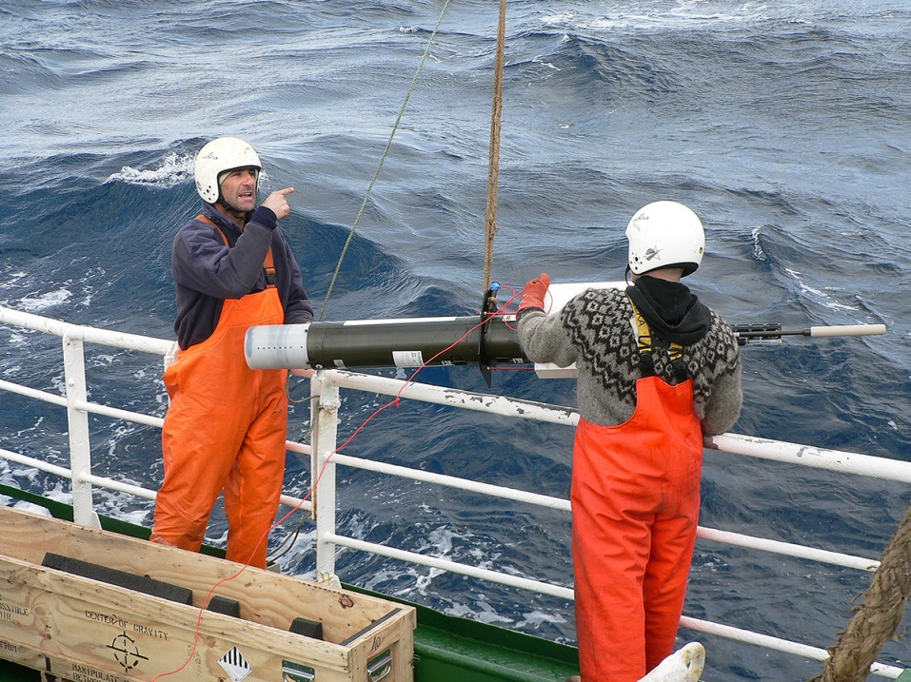
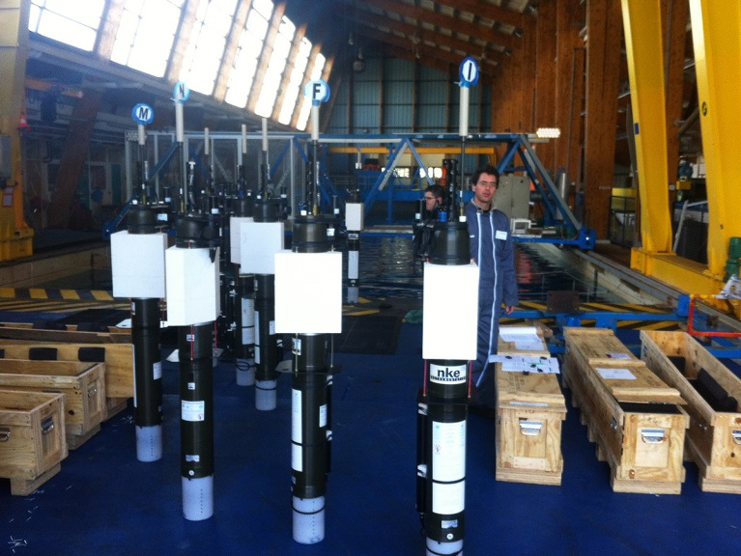
              Development of the CTS4 profiler
Collaboration LOV – IFREMER - NKE
Nice results:
More than 200 floats
First float “Full BGC” deployed
Highly flexible BGC Argo float
➔ But not easy to explore new applications

Slide 5
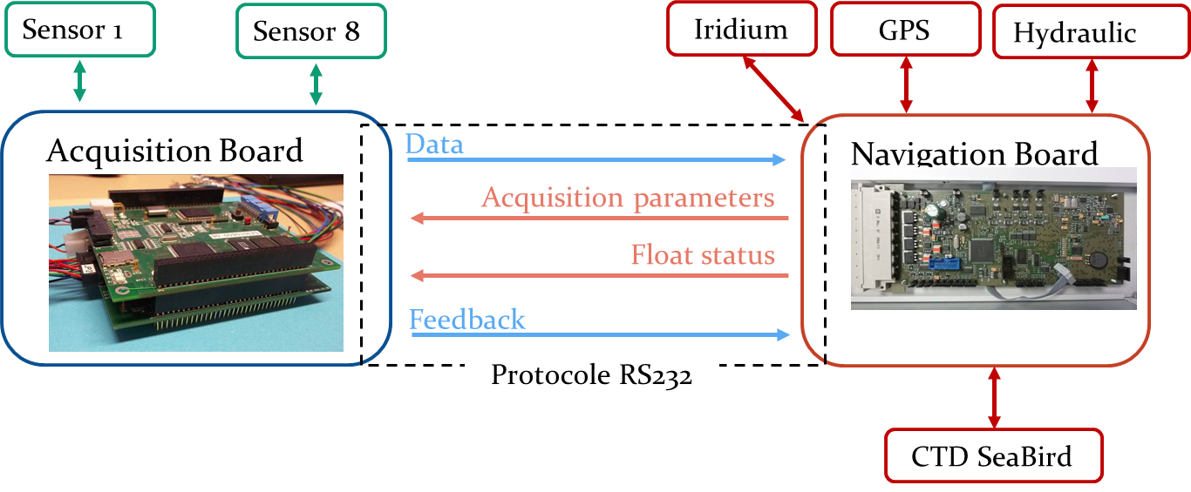


              Development of the CTS5 profiler
How to integrate safely, at LOV, new applications ?
  ➔ dual board strategy. The CTS5 support a protocol to communicate with a user electronic board.
Sensors
Float
Modifiable at LOV = Flexibility
Stable = Security
Collaboration LOV - NKE

Slide 6
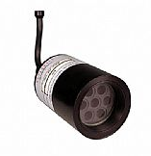
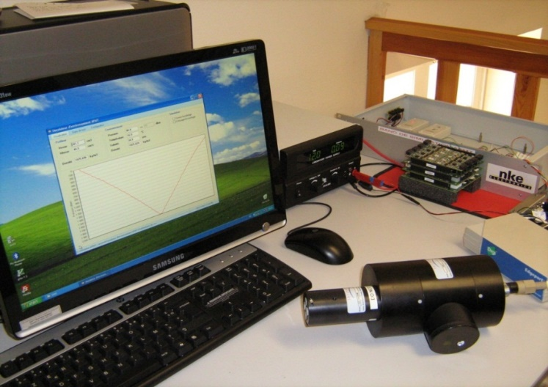
              Development of the CTS5 profiler
How to test our development ?
1- Hardware Bench Simulator
Global checking
Failure mode
Data acquisition bias

Slide 7
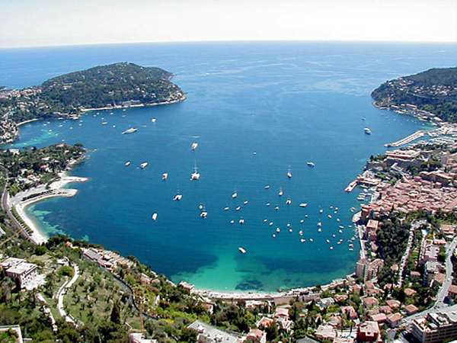
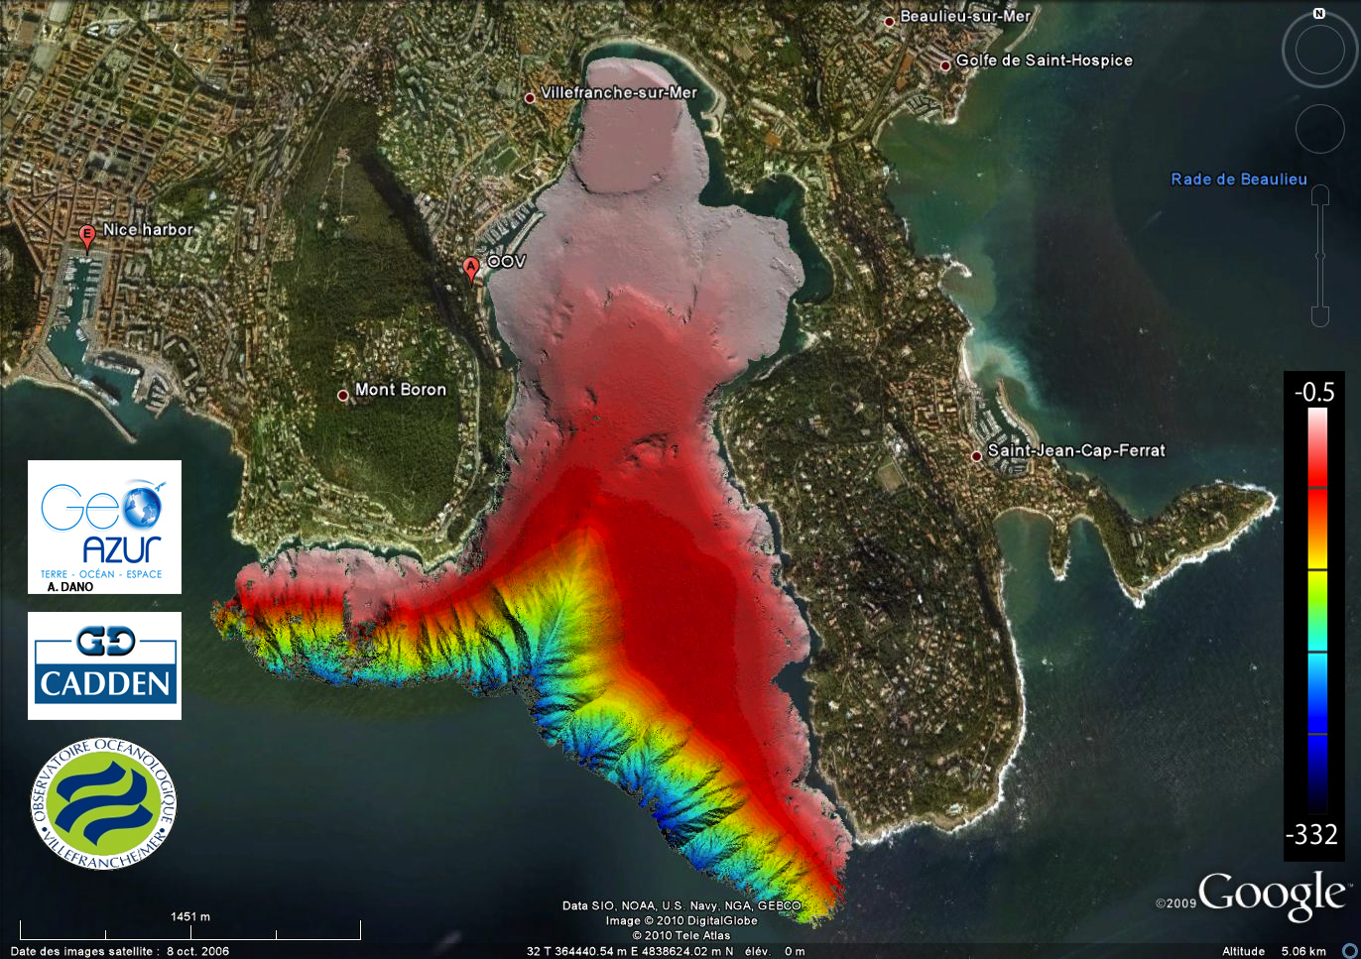
              Development of the CTS5 profiler
How to test our development ?
2- In-situ testing at LOV
1 000 m depth at 4 nm
2000 m depth at 10 nm
Good weather and predictable current for recovery

Slide 8
              CTS5 profiler
              Past and on-going developments
ProVal float
ProIce float
UVP6 sensor
Passive acoustic

Slide 9

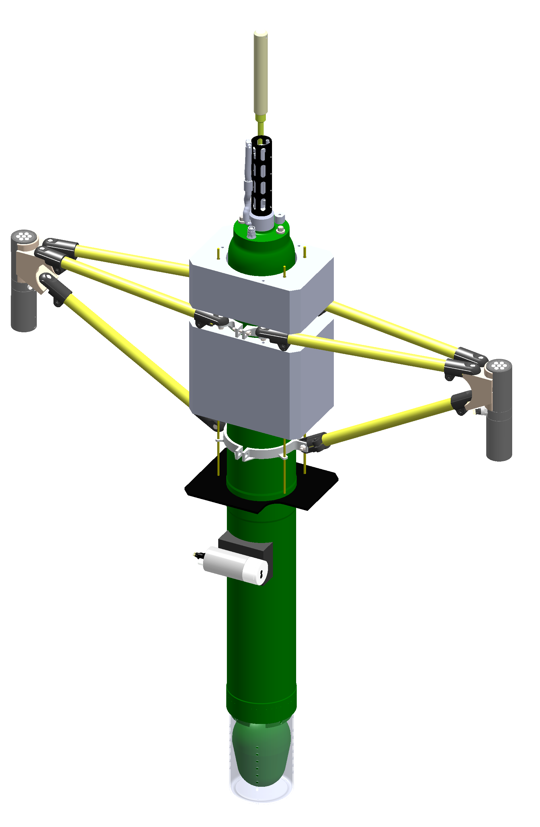
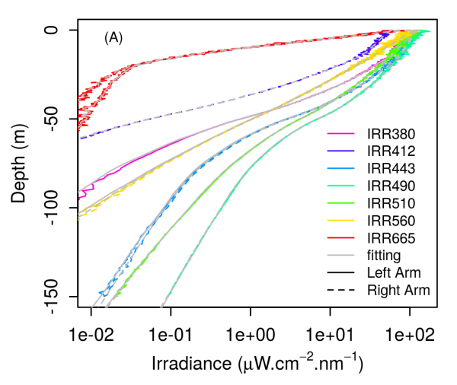
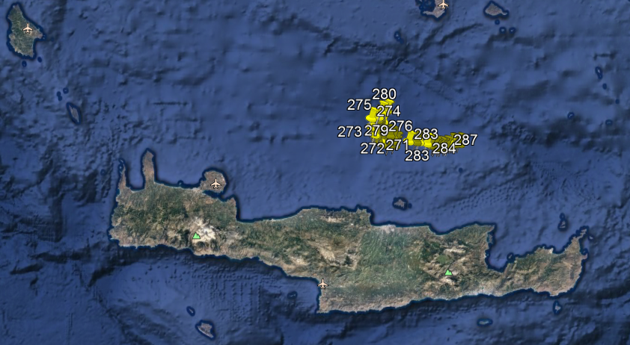
              ProVal: A new float for radiometric measurements
  Irradiance (Ed) and radiance (Lu) at 7 wavelength [380 - 665 nm]
Tilt and compass sensors
Chla, backscattering, CDOM, CTD
GPS & Iridium antenna
temperature & salinity
pressure
3 weeks deployment with HCMR
OCR507-IR
syntactic foam
E_{d}-L_{u} (7λ)
surface
21 cm
ECO
24 cm
tilt & compass (Internal)
65 cm
external bladder (buoyancy)
height : 213 cm
width : 138 cm
weight : 65 kg
➔ Next : integration of Hyperspectral radiometer (EA-RISE)
Already 3 floats and more than 600 profiles. Frontiers in mar. Sc.
https://www.frontiersin.org/articles/10.3389/fmars.2018.00437/full

Slide 10
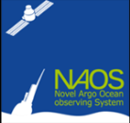

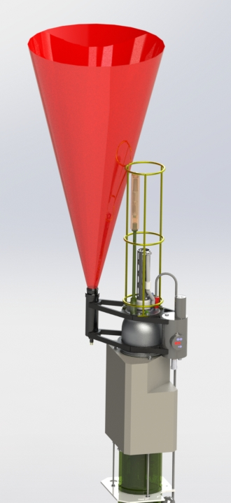
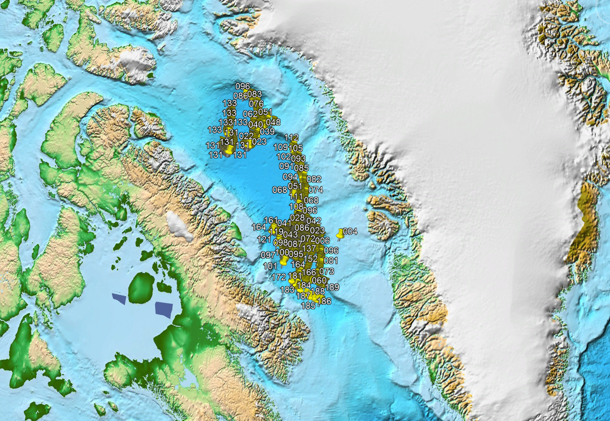
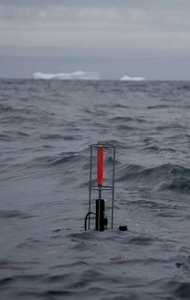
              ProIce: A BGC float for arctic condition
Joint work with C. Marec, J. Lagunas, E. Rehm and M. Babin from Takuvik
Ice avoidance : ISA adapted to Baffin Bay, Altimeter and date criteria programmed on the LOV acquisition board
Change of configuration under-ice (date criteria)
Crédit P. Bourguain

Slide 11
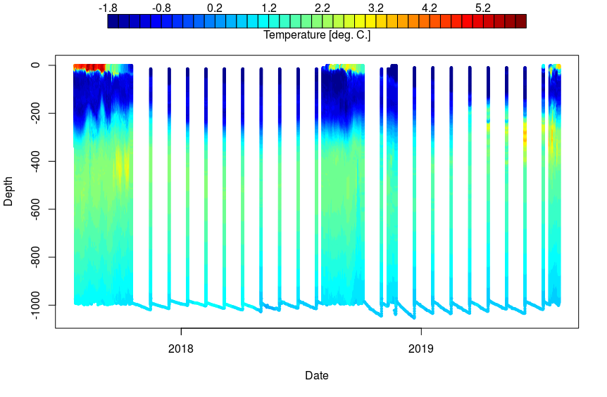
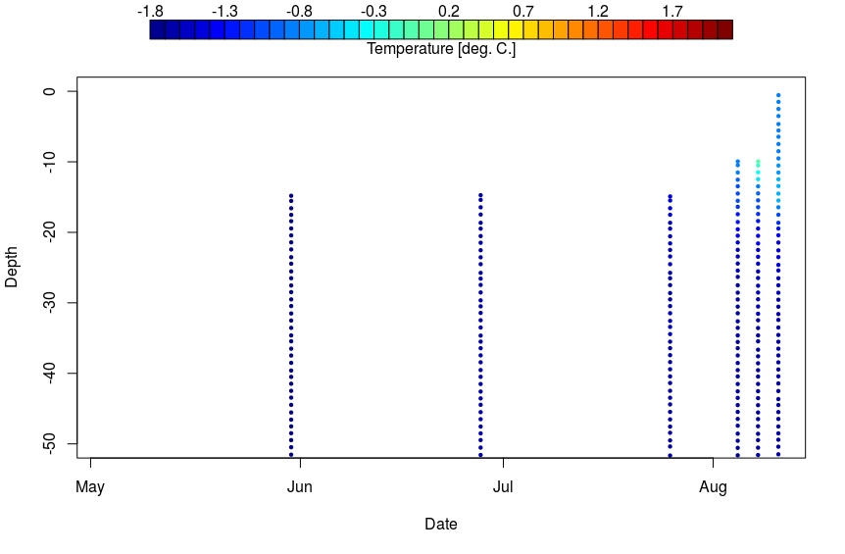
              ProIce: A BGC float for arctic condition
Joint work with C. Marec, J. Lagunas, E. Rehm and M. Babin from Takuvik
Ice avoidance : ISA adapted to Baffin Bay, Altimeter and date criteria programmed on the LOV acquisition board
Change of configuration under-ice (script based - date criteria)
➔ Next : Move to a more industrialized version.
Crédit P. Bourguain

Slide 12
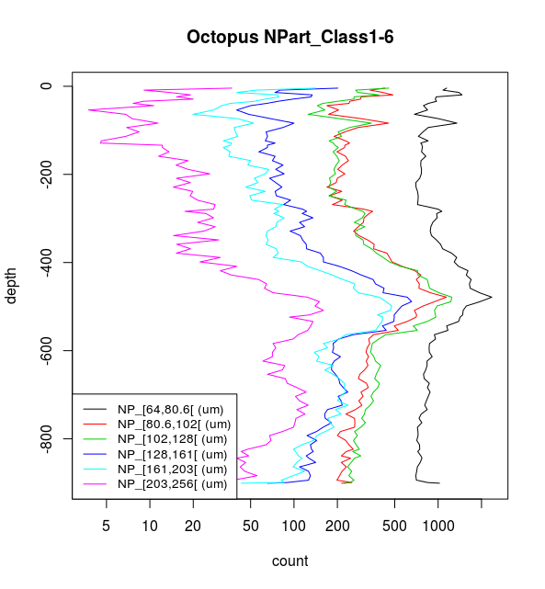
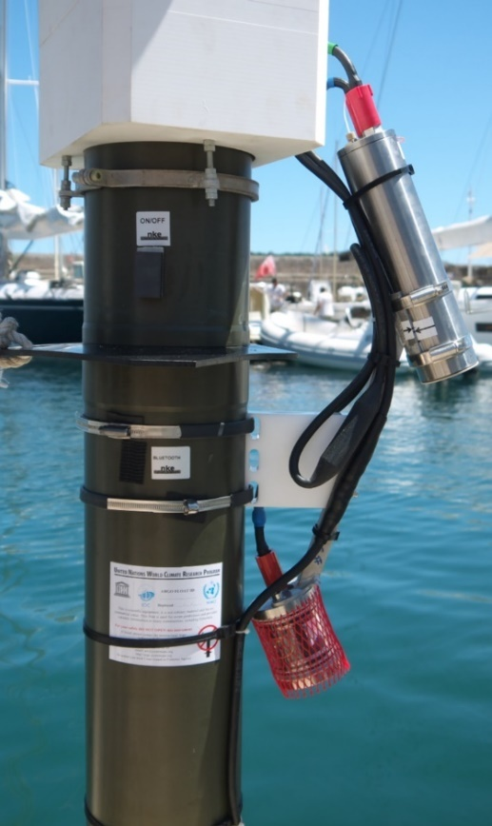
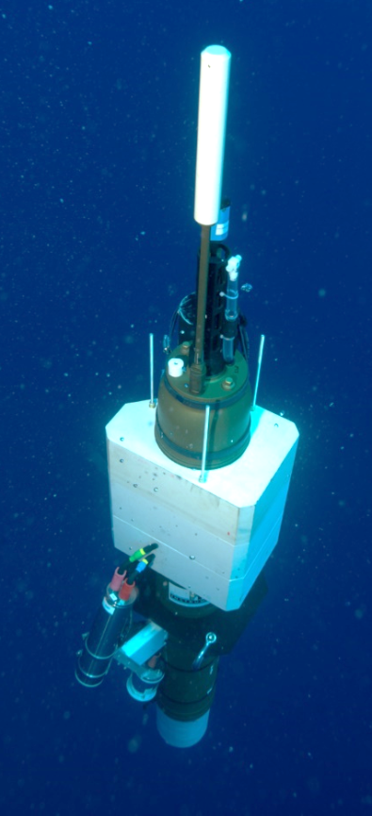


UVP6-LP : Miniaturized Under Vision Profiler
Low power, image based, particle size counter (18 size class, 64 to 4100 µm)
Sensor developed at LOV M. Picheral et al.
➔ Article soumis à Frontiers
➔ Next : Finalize industrialized version.
Projet GOPPI

Slide 13

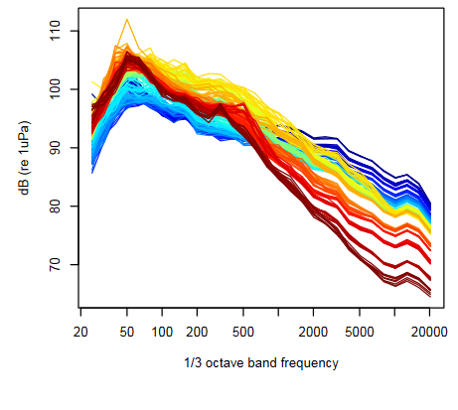




Passive Acoustic Monitoring
Joint work with J. Bonnel (Whoi) and D. Cazau (ENSTA)
Estimate wind speed and rainfall from parking depth
Passive acoustic recorder (RTSys) and transmission of 30 FFT bands (1/3 octave) per acquisition
Several short deployments (1 week)
Color = time scale
BGC - Argo
➔ Next : achieve longer deployments (ERC – REFINE)
acoustic monitoring
anthropic
cetacean
Wind
Rain
Ice

Slide 14
Overview and future developments.
Conclusion on the acquisition board managed by LOV
  Created a lot of opportunities for testing new applications
  But difficulties when you want to industrialize these applications
➔ New Development with NKE : CTS5 - USEA
  Increased capabilities for BGC-Core Argo
    Mission and sampling flexibilities
    Increased Rudics speed
    GUI configuration tools
  Room for new applications developed by LOV but with easier industrialization
    New sensor
    Advanced On-Board Processing

Slide 15
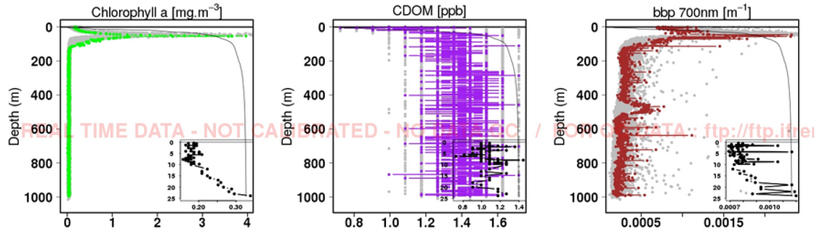
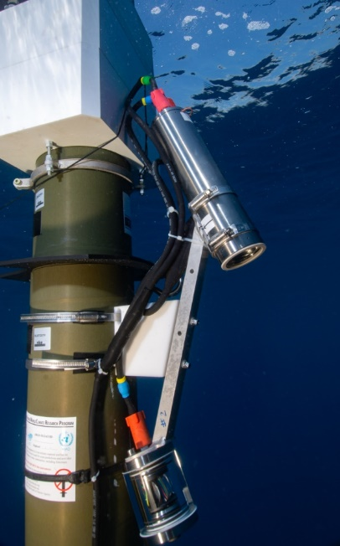
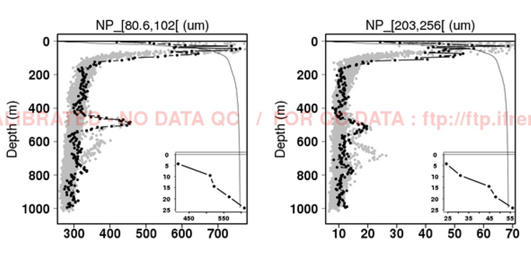
CTS5 – USEA : First Results
Integration of the UVP6 sensor as commercial product
Thanks to C. Schmechtig, JP Rannou and T. Carval for data handling

Slide 16
Perspectives
A lot of new applications are waiting to be implemented on floats
Very significant progress is being made to reduce sensor power consumption (ex. UVP ➔ 20 times less in 10 years) opening new applications for Argo floats
The bottleneck for the next decade is the telemetry !
➔ Need to work on “On-board processing” for images, sound identifications, data reduction, …
Iridium Certus 100
Rudics
Iridium Certus 20

Slide 17
Merci

