Slide 1
TCR repertoire as biomarkers of immune diseases : applications to autoimmune diseases and Covid-19

Slide 2
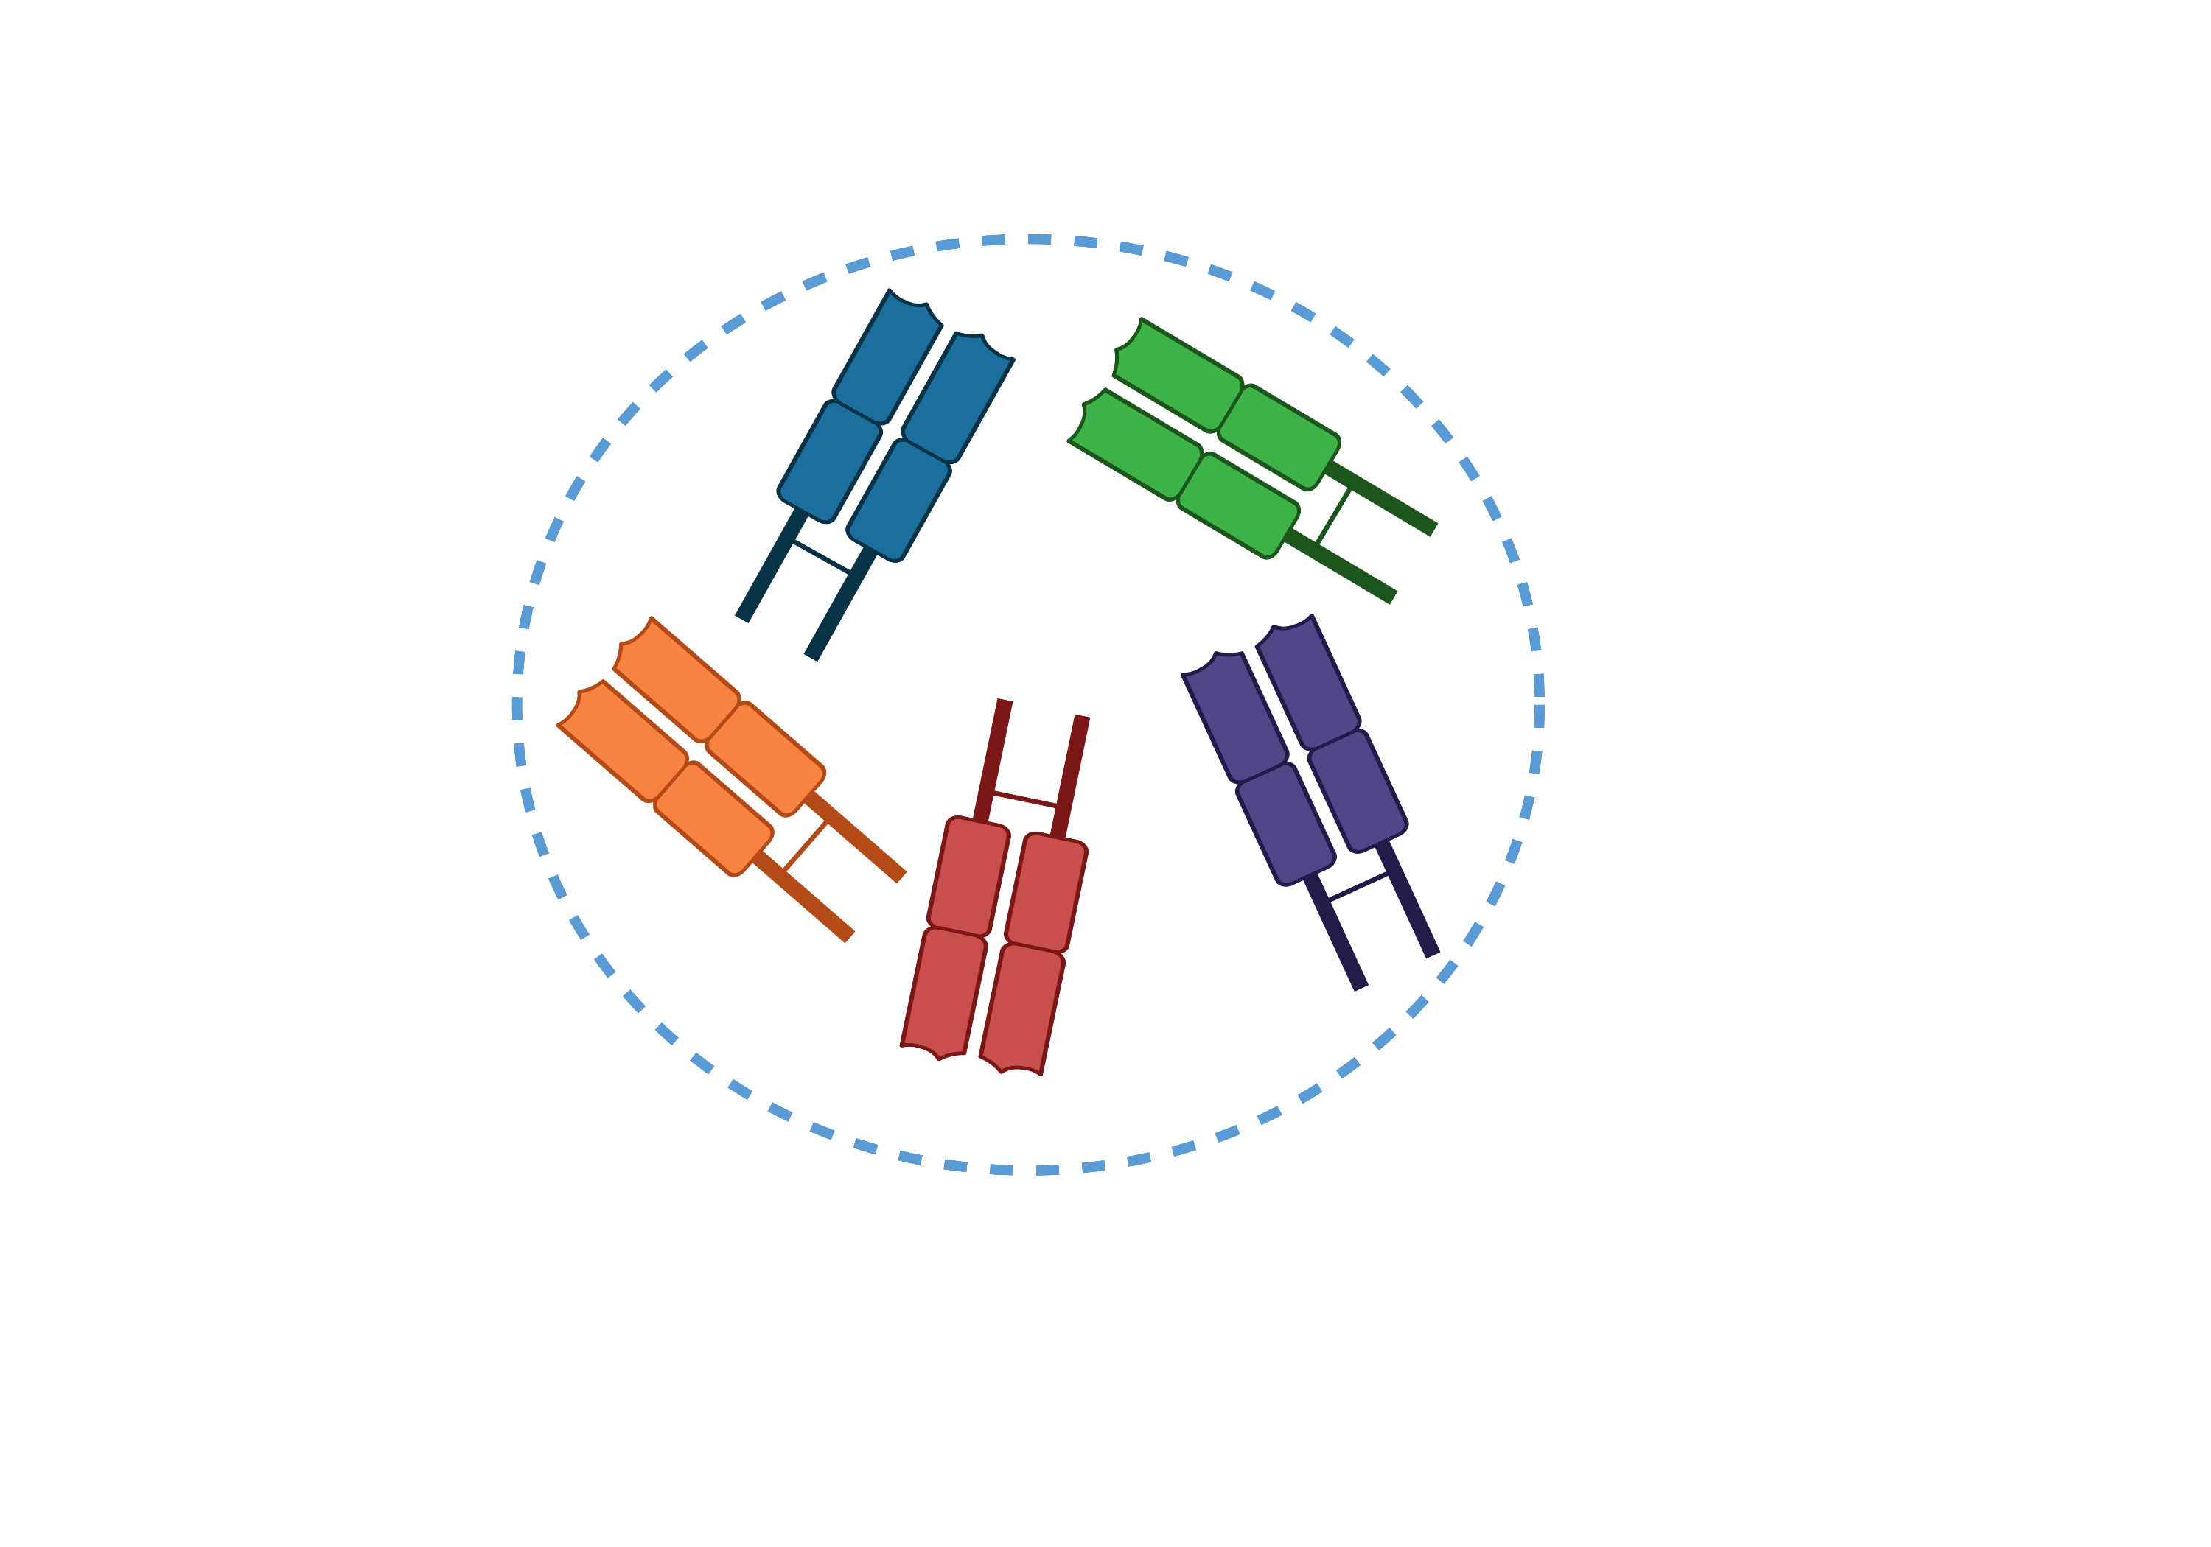
Background & Aims
Adaptative T-cell repertoire diversity
Aims
Identify disease-specific TCRs from the repertoire of sorted T cells
Use these sequences to classify and predict patient outcome
Determine the specificity and biological roles of these TCRs to better understand the diseases
Notes:
1min
The immune system is a dynamic biological object whose modifications will dependent on cell populations and the amplitude of the response according to the types of antigens encountered (microbial, self-antigens). It can be assumed, as shown in some papers, that this dynamic results from an activation of specific T cell receptors. The TCR could thus be used as a biomarker of a pathology.
Thus our objectives are
Identify disease-specific TCRs from the repertoire of sorted T cells
Use these sequences to classify and predict patient outcome
Determine the specificity and biological roles of these TCRs to better understand the diseases

Slide 3
Methods
Notes:
1min45
We launched two observational trial, the first one is Transimmunom to revisit the nosology of autoimmune diseases. At this time, we are focusing on type 1 diabetes (T1D) and rheumatoid arthritis (RA). The trial also includes healthy volunteers (HV). The second trial is SirocCo, aimed at investigating the mechanisms of cell subsets in COVID-19 patients.
For each trial, we sorted the CD4 T-cell subpopulations from peripheral blood: effector T-cells (Teff) and regulatory T-cells (Treg), and sequenced their TCR𝛼β repertoire.
We focus the analysis on CDR3 amino acide. After the application of our identification strategy, which I will not detail, we isolate for each disease, two types of signatures. One that corresponds to the enriched sequences in the disease and one that corresponds to the impoverished sequences.
A very important point for us, beyond the identification strategy, is to validate the approach and the ensuing results.
Is the signature a biological reality or the result of chance? Can it be used to identify patients and thus serve as a biomarker? To what extent is it specific to our dataset and therefore subject to sampling or experimental bias? Is it found in external datasets ?
We use two approaches.The first is to use machine learning to train a model on 75% of the patients with whom the signature was made and then to classify the remaining 25%.
The second approach is the use of external data sets.

Slide 4
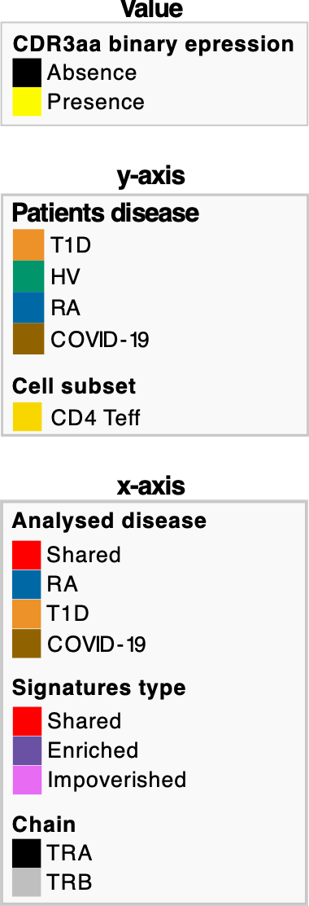
Signatures
Transimmunom
SirocCo
Cluster purity : 0.83
Cluster purity : 1
The selection of CDR3aa from periphical blood works well on a viral disease like COVID-19 since the clustering shows a perfect separation of patients from HV.
The strategy also separates AIDs patients from HV but to a lesser extent.
Notes:
2min
After applying our strategy to the Transimmunom dataset for autoimmune diseases on the left and to the SirocCo dataset for COVID-19 on the right, we identified disease-specific CDR3aa. These sequences are represented here as a heatmap, with their presence in yellow and absence in black across all patients. For the sake of clarity, only the CD4 effector results are shown here (pointer), the disease of each patient is indicated here (pointer). Ward's clustering method is applied on the patients to disciminate those who share the same sequences. For the signatures identified in each disease (pointer), it is specified if this sequence is enriched in the disease or impoverished (pointer) and if the sequence comes from the alpha or beta chain (pointer).
We see blocks of sequences specific to each disease. These are clearer for COVID-19 and allow a better clustering of the patients.
The selection of CDR3aa from periphical blood works well on a viral disease like COVID-19 since the clustering shows a perfect separation of patients from HV.
The strategy also separates AIDs patients from HV but to a lesser extent.

Slide 5
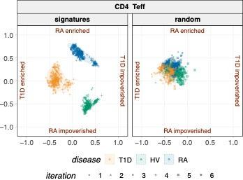
Signature validation 1/4 : Random
Transimmunom
The strategy is reproducible, little impacted by sampling, and that the results are not due to chance.
Notes:
1min
A first validation is the comparison of our signatures versus random signatures. That is to say, of the same size as the one identified but with sequences drawn from the whole dataset. The radviz represents the CDR3aa expression of the 4 AID signatures for each patient. The signatures were calculated on 75% of the patients of each disease. 6 random draws of the dataset were performed (iterations).
The random signatures did not separate the patients, whatever the iterations, which shows that the strategy is reproducible, little impacted by sampling, and that the results are not due to chance.

Slide 6
Signature validation : …
See you on my poster 202 or on Whova
Poster features : ML classification, prediction of disease outcome, …
Notes:
15sec
The second validation of our strategy was to …
Actually, I'll let you discover the rest by going to my poster, number 202 or on whova (it’s accessible with this QR code).

Slide 7
Acknowledgements
i³ Laboratory
David Klatzmann
Sequencing facilities
IGENSEQ / ICM
Yannick Marie
Agnes Rastetter
Equipex LIGAN-PM / CNRS UMR8199
Julien Derop
Naomie Ramphft
Raphael Boutry
Amelie Bonnefond
Collaborators
Francis Berenbaum
Jérémie Sellam
TI consortium
TCR Team
Encarnita Mariotti-Ferrandiz
Adrien Six
Pierre Barennes
Vanessa Mhanna
Gwladys Fourcade
Helene Vantomme
Kenz Le Gouge
Nicolas Coatnoan
Leslie Adda
Human immunology Team
Michelle Rosenzwajg
Caroline Aheng
Roberta Lorenzon
Claire Ribet
Michèle Barbié
Alexandra Roux
Fabien Pitoiset
Marie Binvignat
Signe Hassler
Nicolas Tchitchek
Notes:
30sec
To conclude I would like to thank the team I work with at i3 lab and our collaborators.
I would particularly like to thank David Klatzmann the director of the laboratory and my thesis supervisor, Encarnita Mariotti-Ferrandiz my second thesis supervisor, and Pierre Barennes a PhD student without whom the project would not be here.
Thank you for your attention !

